Slide 1
DEPARTMENT OF COMPUTER SCIENCE & ENGINEERING
PROJECT WORK
CT WORK- CSE499
FINAL REVIEW
SPEECH RECOGNITION AND TRANSLATION USING MACHINE LEARNING
BATCH MEMBERS:
M. MOUNIKA (20691A05C6)
M. PREETHI (20691A05D6)
K. ROHINI (20691A05E7)
S.SUCHITRA (20691A05H3)
GUIDE:
Mr. K.SATHISH , M.Tech., Asst. Professor

Slide 2
ABSTRACT
The advancement of human species in technical field is parallel to the development of civilizations and resulted in multiple languages as a medium of communication. Such an advancement also made it difficult for the people to communicate as each civilization has different languages. We have almost tried all methods of language translation and almost achieved the state of art (top class) results. We have adopted a method of machine translation (usage of machine learning for translation) which happens in the server side and helps the users to translate by sending a GET or POST request through JQuery and translating the data. This can be accomplished by three steps:
1.Speech recognition (conversion of spoken words to text)
2. Translation using machine learning
3. Speech synthesis (conversion of translated text to audio) .

Slide 3
OBJECTIVES
The main objective of this project is to translate the speech from any type of audio language(Tamil, Telugu, etc., ) to any type of audio language(Hindi, English, etc.,).
It will recognizes the audio signals by using acoustic model.
Then the recognized audio signals will be converted to text by using the non AJAX GET request from the API .
Also it will speak out the translated output back in the language selected by user.

Slide 4
INTRODUCTION
English, also recognized as business lingua franca, is used in foreign organizations, and has official language status in more than 20 countries. Although it is easy to recognize English as a standard, the simplification leads to a lots of opportunity for organizations that have their content restricted to one specific language. Considering the high cost of translators, reviews, and domain specificity, it is easy to conclude that providing services in a single language may be better for a company; but businesses may be excluding themselves from new markets by limiting content to a few languages. There are "business languages" due to increased globalization, and the importance of multi-lingual content in today's culture is paramount.

Slide 5
USING DEEP LEARNING
Years ago the translation of the text from an unknown language was very time consuming. The use of basic vocabulary and word-to-word translation was difficult for two reasons:
The reader had to know the grammar rules. All language versions had to be kept in mind while the entire sentence was being translated.
Now, we don't have to struggle too much – just by bringing them into google translate, we can translate words, sentences and even big texts. But in fact most people don't know how the machine learning translation engine operates and deep learning translation problems.
If the Google Translate engine wanted to keep the translations only for short sentences, because of the large number of potential variants, this would not work. The best idea may be to teach and translate the sentences according to the code sets of grammar rules. Modern machine translation systems use a particular approach: by examining a large collection of documents, they assign the rules from text.

Slide 6
Literature Survey
S.No | Title | Author | Journal/ Conference | Year of Publish | Remarks
1. | A Deep Learning based intelligent quality detection model for Machine Learning. | Meijuan Chen | Journal | 2023 | Developed towards the quality evaluation of machine translation results using double RNN algorithm. It did not achieve the oral expression of the speaker.
2. | Wavelet transformer for Automatic Speech Recognition of Indian Languages. | Tripti Choudhary | Journal | 2023 | The wavelet can analyse a signal at multiscale like variability in voice, gender, etc. This model is developed for Indian languages.
3. | Bangla Natural language processing | Ovishake Sen | Journal | 2022 | Developed using RNN ,CNN algorithm for transforming Bangla Language. Also in Bangla, an adjective can be used as proper noun. Like person can be SUNDAR(beautiful) which is adjective.

Slide 7
Literature Survey
S.No | Title | Author | Journal/ Conference | Year of Publish | Remarks
4. | Mobile platform Speech Intelligent Recognition and Translation App | L.V. Ping | Conference | 2021 | Only text input which has certain inconveniences and lacks translation references sentences in the specific situation.
5. | Re-Translation strategies for Long form simultaneous , spoken language Translation | Naveen Arivazhagan | Conference | 2020 | Enables us to comprehensively measure the performance of simultaneous translation system using Neural Machine Translation. But doesn’t change the output from text to speech.
6. | Image Text to Speech Conversion Using OCR Technique | K. Nirmala Kumari | Journal | 2019 | Only image Translation. Text to speech device can change the text image input into sound with performance that is high, does not require internet connection.

Slide 8
Literature Survey
S.No | Title | Author | Journal/ Conference | Year of Publish | Remarks
7. | Embedded Optical Character Recognition On Tamil Text Image | V. Anantha Devi | Journal | 2018 | No Speech Synthesis. Helps the visually challenged to read books. It is implemented only for the conversion of printed Tamil text.
8. | Reading Assistant for the Visually Impaired | Anusha Bhargava | Journal | 2017 | No use of Raspberry pi. The input is an image format to deduce some information from it and output can be an image or set of parameters obtain from image by using Optical Character Recognition.
9. | Speech to text conversion | M. Sudhakar |  | 2016 | No raspberry pi connectivity

Slide 9
Literature Survey
S.No | Title | Author | Journal/ Conference | Year of Publish | Remarks
10. | Text to Speech Conversion | S. Venkateswarlu | Journal | 2016 | Text is extracted from the image and converted to audio by using Optical Character Recognition and Text to Speech Synthesizer but do not translate speech to text
11. | Voice Command System | Surinder Kaur | Journal | 2015 | The project design involve text to speech by using Raspberry Pi but gives exact translation which has no meaning.
12. | Text to Speech Conversion Using Raspberry-pi for Embedded System | P.V.N. Reddy | Journal | 2014 | The proposed Text to speech (TTS) system designed to produce an equivalent synchronization with the text which is provided as an input to the Raspberry-Pi system. No use of Raspberry pi

Slide 10
Literature Survey
S.No | Title | Author | Journal/ Conference | Year of Publish | Remarks
13. | Intelligent Translate System for Visually challenged People | Raja Venkatesan .T | Journal | 2012 | Image processing and embedded system technology is used in this project. This paper is being presented as a solution for the conversion of images into sound using MATLAB code.
14. | Design And Implementation | K. Lakshmi |  | 2013 | No speech to text
15. | Language Translator | R. Sharmila |  | 2009 | No speech Recognition

Slide 11
EXISTING WORK
The data given in previous models is sent to a cloud such as Azure where it uses native translators such as Microsoft translators or Google Cloud Translate. The problem with such a model is that these cloud services are using Interlingua methods.
An Interlingua is approach where a given language is translated to an intermediate language then intermediate language is translated to target language.

Slide 12
Issues in Existing Work
In earlier days the translation made by using dictionary.
Later the data given is sent to a Cloud like Azure where it uses the native translators like Microsoft translators or Google cloud Translate.
The issue with such model is that these Cloud services use Interlingua methods
Let me get this straight. An Interlingua is approach where a given language is translated to an intermediate language followed by the intermediate language is translated to target language.
But what is the problem ??
This produces good results with bad syntax , that is the translated text has exact translated words with bad order.
Source language
Intermediate language
Destination language

Slide 13
Proposed work:
In the year 2008, Google thought this method was not giving accurate results and introduced it’s favorite machine learning into the race and came up with Google Translate. Such a method is called “Statistical Machine Translation”
The popular approach is to break down the Source text into segments and compare them to the bilingual corpus and producing a bunch of translated texts and comparing them to predict the output based on their Secret probability method.
Here as the obtained result has no intermediate language , the translation in bi directional and the results are found to be 89% right as per the Analysis.
And we as an intern at Dial Engineers adopted the same statistical machine translation to provide translations to their Product “Assistant Sherlock”
The translation of Google supports 128 languages and Microsoft provides 96 languages, we support 94 languages with 73 % accuracy.

Slide 14
ARCHITECTURE DIAGRAM
Sentence given by user : Word 1 Word 2 Word 3 Word 4
BI LINGUAL CORPUS
Word1
Word 2
Word 3
Word 4
Translated Word 1
Translated Word 2
Translated Word 3
Translated Word 4
PROBABILITY FUNCTION
Word 1
Word 2
Word 3
Word 4
Combi 1
Prob: 67%
Word 1
Word 2
Word 4
Word 3
Combi 2
Prob: 83%
Word 2
Word 1
Word 4
Word 3
Combi 3
Prob: 89%
Final Output
Word 1
Word 4
Word 3
Word 2
Combi 16
Prob: 73%
or
Word 1
Word 4
Word 3
NR
Combi X
Prob: 73%
Final Output
NR : words not significant or not found in new language

Slide 15
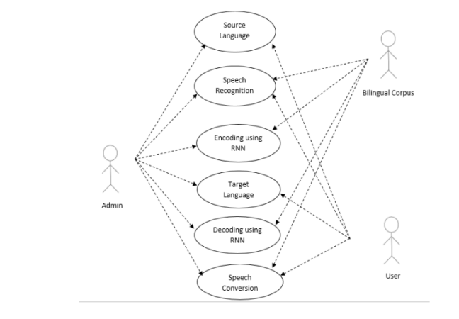
UML DIAGRAMS
USE CASE:

Slide 16
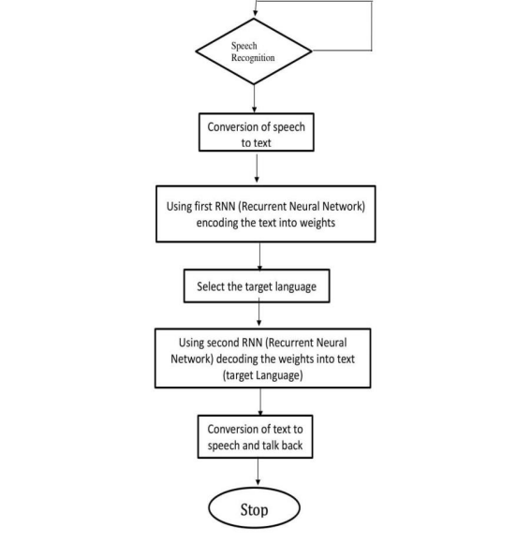
FLOW CHART :

Slide 17
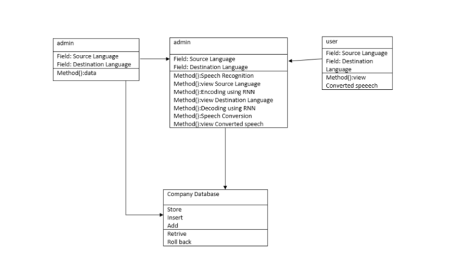
CLASS DIAGRAM :

Slide 18
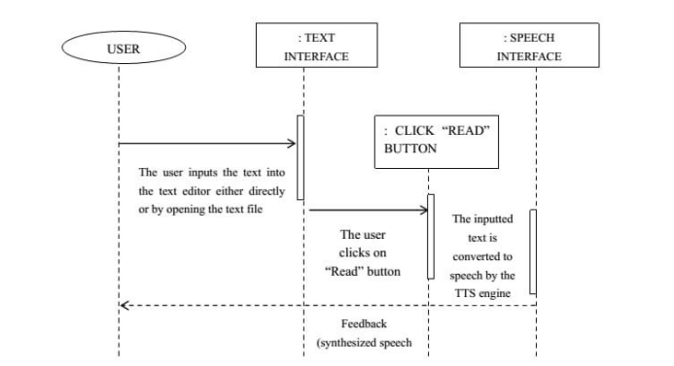
SEQUENCE DIAGRAM :

Slide 19
Brief Module Description
Why API’s:
The natural language processing needs large GPU’s in huge count as the training data for each language differs and the training pairs are to be loaded from scratch which takes large computational speeds to run on a normal computer. Instead we use API, which makes the large GPU’s at the company and cloud storage for database(trained data) to provide the results in less time.
In what way we are different:
As many of others are using the predominant google translate’s approach which uses the STM(Statistical Machine Translation) via bilingual corpus. We adopted probability to find the best matched translated text as an added feature. Also we generate every possible combination of translated text before sending them to probability function.
How Pronunciation is identified:
When a person speaks then the audio signals will be converted into digital signals and then it will be split into small pieces of audio data and then each audio will then be processed by the speech recognizer.

Slide 20
Why non Ajax why not Ajax: Ajax(Asynchronous JavaScript and XML) : Whenever we need to send a request or to access the data from the server then Ajax is used. It will send and receive the data in the JSON format which is used in Js to display it in webpage. But Ajax is only used to take the input as text and other metadata , it will not support any other formats like audio and video. Non AJAX: It is quite similar to the Ajax, and also it is just an extension to Ajax request which supports JavaScript, XML, audio and video formats. We use non Ajax request because we need to send audio (spoken) and get back audio(translated mp3) which is not supported by Ajax.

Slide 21
Acoustic Model(Sound)
Speech signal 1
Recognized Speech Signal
Speech signal 2
Speech Recognizer
Speech Recognizer
Language model (Structure)
Speech signal n
Converted to text
Recognized text
Converted to text
Database
Converted to text

Slide 22
System Requirements
Software Requirements:
HTML 5.0 / CSS
JavaScript 6
JQuery 3.0
Hardware Requirements:
PROCESSOR: Intel core i3
Hard Drive: Minimum 32 GB
Memory (RAM): Minimum 1 GB

Slide 23
Methodology Used :
The methodology of this project is firstly we need to select the source language and then we have to speak on the mic.
It will detect the speech and then it will converted into speech by using the web search API and then the browser will convert that speech into text and then it will be displayed in the test box.
Then we can translate the source text into the destination language by selecting the language and the GET request will be sent to the server and the translated text will be sent through the non AJAX POST request and it will translated and it will also be printed in the text box.
We can also make that speech to speak back in the destination language.

Slide 24
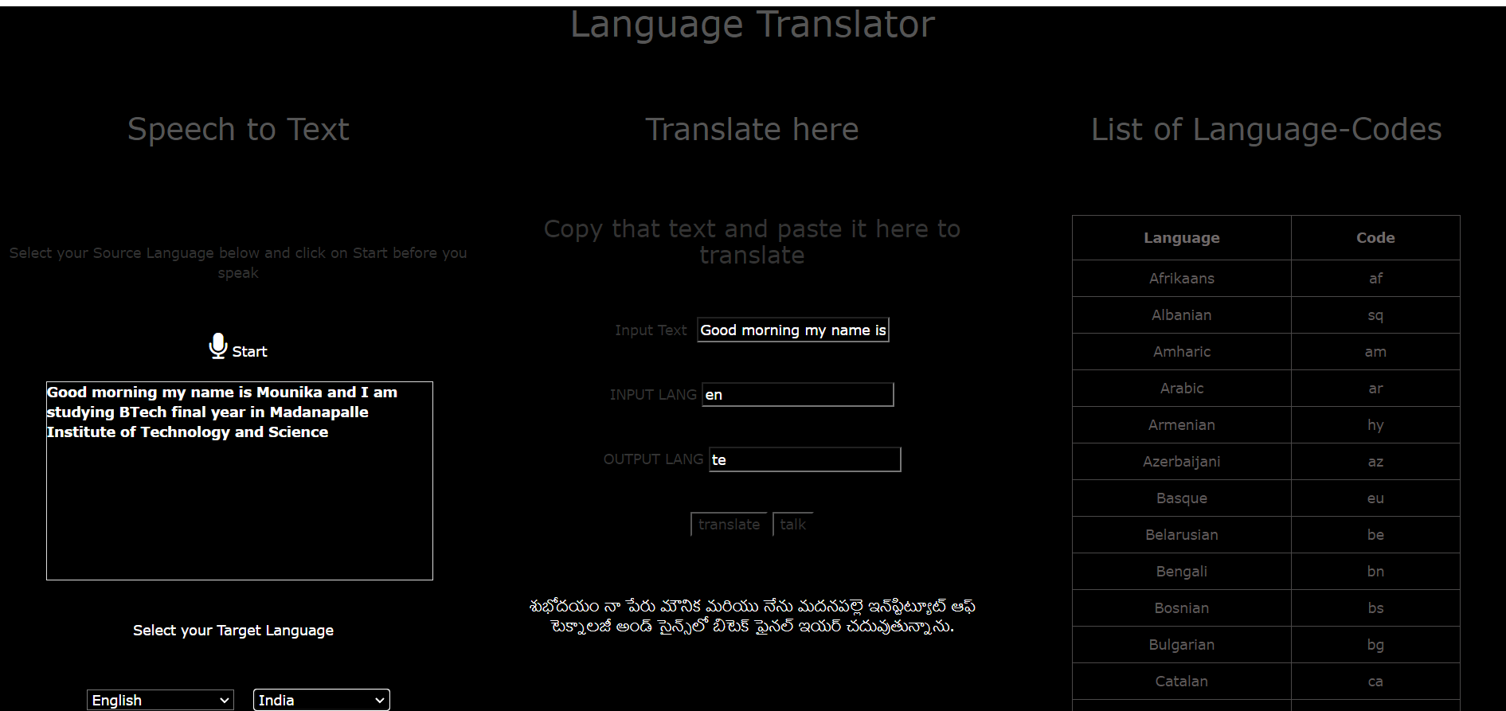
Output Screenshot

Slide 25
Details of International Conference
Attended international Conference on Intelligent Computing (IConIC) on 22.03.2024.

Slide 26
CONCLUSION AND FUTURE WORK
No matter how good the qualified data are, errors will still remain. Our system's maximum performance of translation accuracy was 87% and an average of 72%. On the other hand, speech recognition has an average accuracy of 88% which is very popular for models of speech recognition. Considering that speech recognition models are too frequently our translation accuracy needs to be enhanced. In addition, using the same model and some improvements in speech recognition, we can create the translation model that can be enhanced to detect text in images and to translate the text in the images into the language desired when pointed towards the camera.

Slide 27
REFERENCES:
1 Tiago Duarte, Rafael Prikladnicki, Fabio Calefato, Speech Recognition for Voice-Based Machine Translation. Published on IEEE SOFTWARE during Jan/Feb 2014.
2 Akshay Suresh Deshpande,Keshav Shesharao Ambulgekar,Kedar Raghunath Joshi, “Voice to Voice Language Translation System”. International Journal of Engineering Research & Technology (IJERT) ISSN: 2278-0181, Vol. 3 Issue 10, October- 2014.
3 Raja Venkatesan.T, M.Karthigaa, P.Ranjith, C.Arunkumar, M.Gowtham, “Intelligent Transalate System for Visually Challenged People” International Journal for Scientific Research & Development (IJSRD), ISSN (online): 2321-0613, Vol. 3, Issue 12, 2016.
4 Anusha Bhargava, Karthik V. Nath, Pritish Sachdeva, Monil Samel (April 2015), “Reading Assistant for the Visually Impaired” International Journal of Current Engineering and Technology (IJCET), E-ISSN 2277 – 4106, P-ISSN 2347 – 5161, Vol.5, No.2.
5 Gupta, K., & Gupta, D. (2016, January). An analysis on LPC, RASTA and MFCC techniques in Automatic Speech recognition system. In Cloud System and Big Data Engineering (Confluence), 2016 6th International Conference (pp. 493-497). IEEE.

Slide 28


